Slide 1
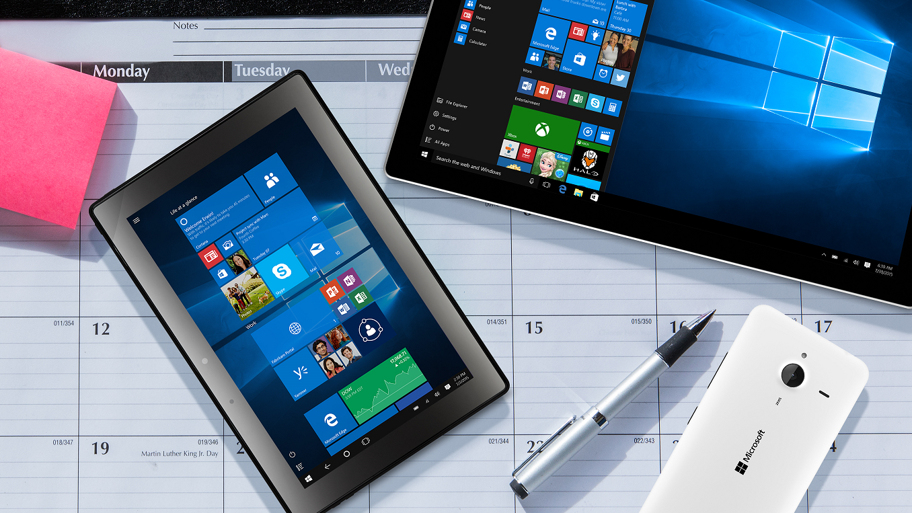
Windows Store for Business
Overview for organizations

Slide 2
Organizational needs
Store designed for organizations
One place to acquire and distribute apps in volume
Simple and easy for users

Slide 3
Windows Store for Business
One place for IT professionals to find, acquire, manage, and distribute apps in volume to Windows 10 devices
Features Windows apps for business and educational users
Helps to manage Windows Store and custom line-of-business apps in one place

Slide 4
Windows Store for Business
The personas

Slide 5


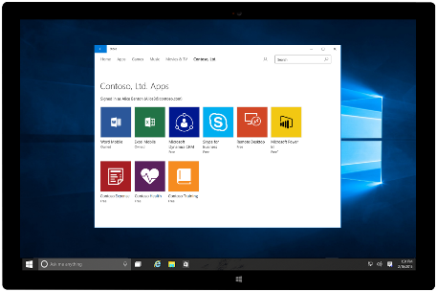
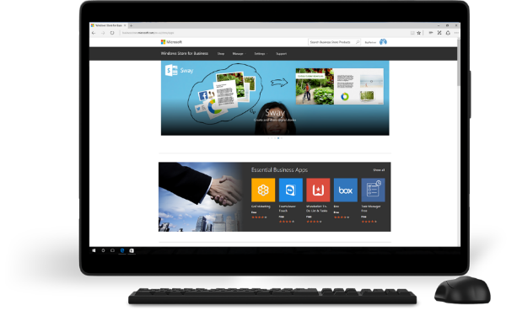
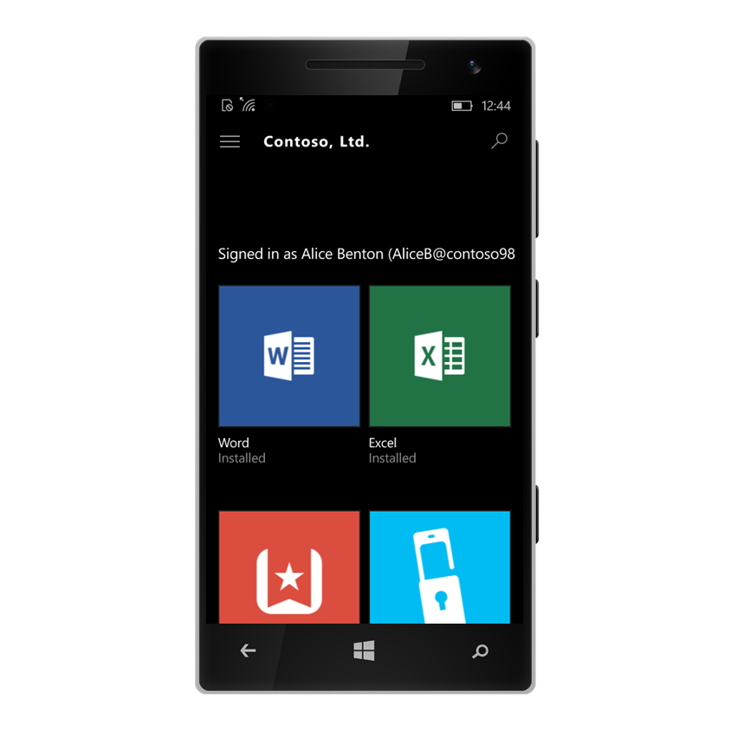
Typical user roles
Alice Benton
User
Contoso, Ltd.
Jerry Fryer
IT Professional
Contoso, Ltd.

Slide 6
Demo: Windows Store for Business
What does Alice see?
Client for the PC

Slide 7
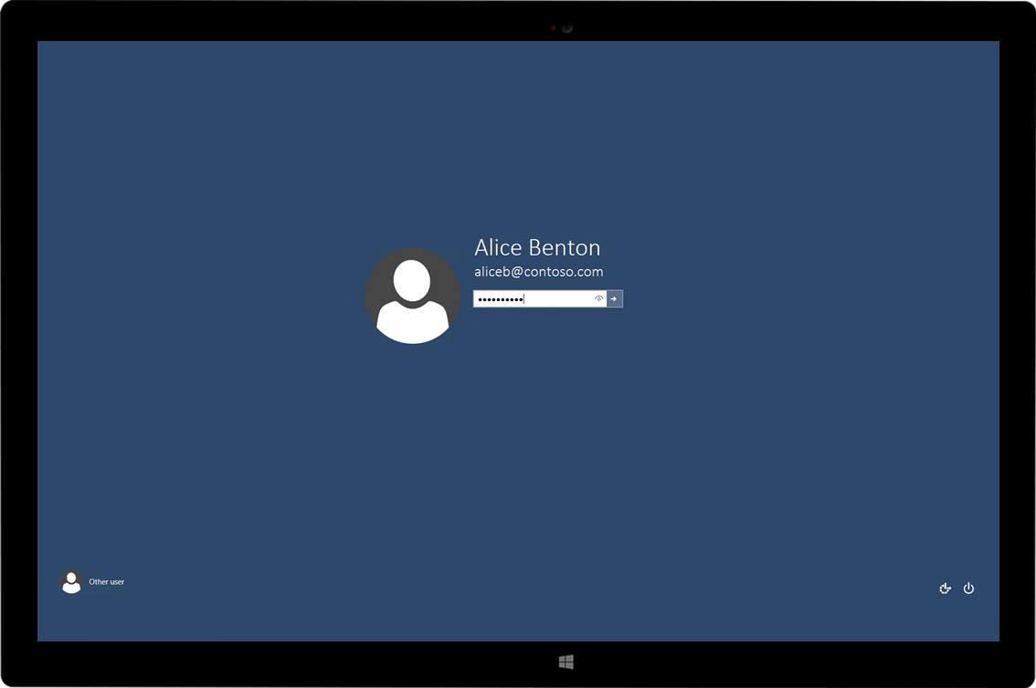

Slide 8
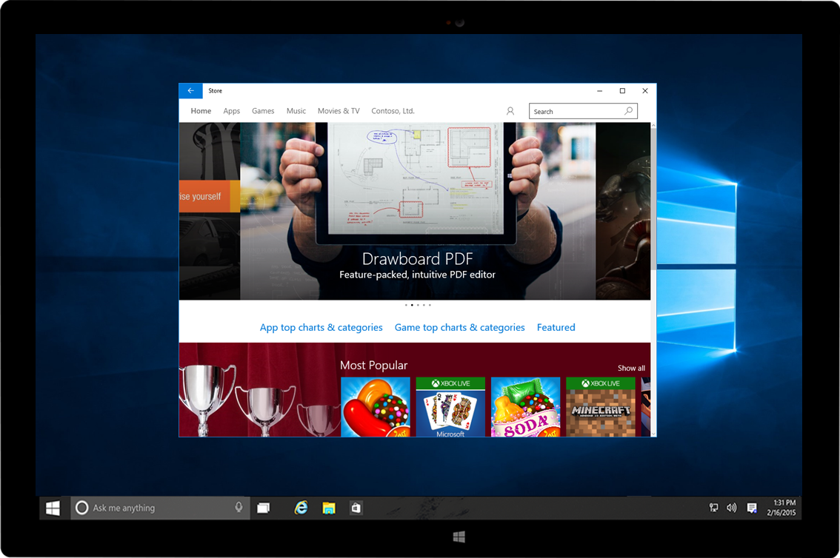

Slide 9
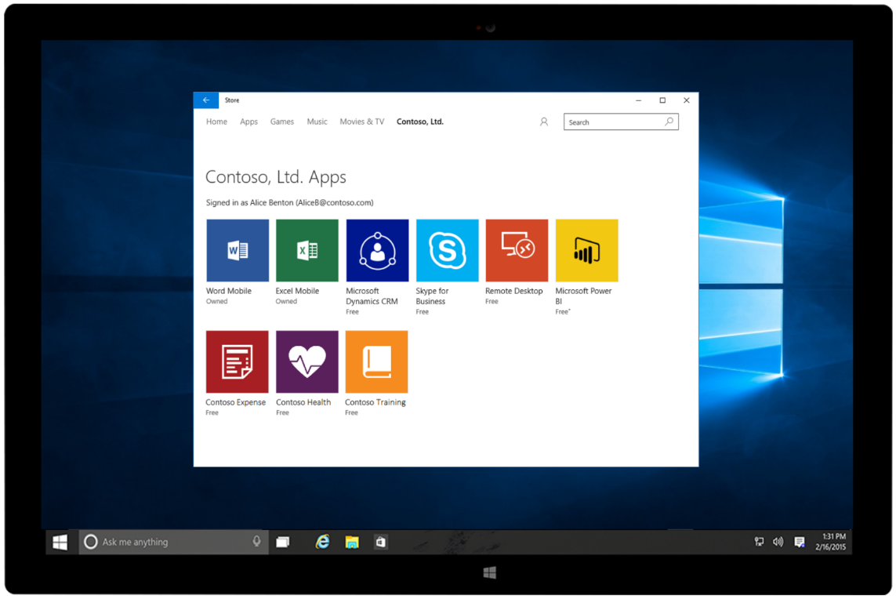

Slide 10
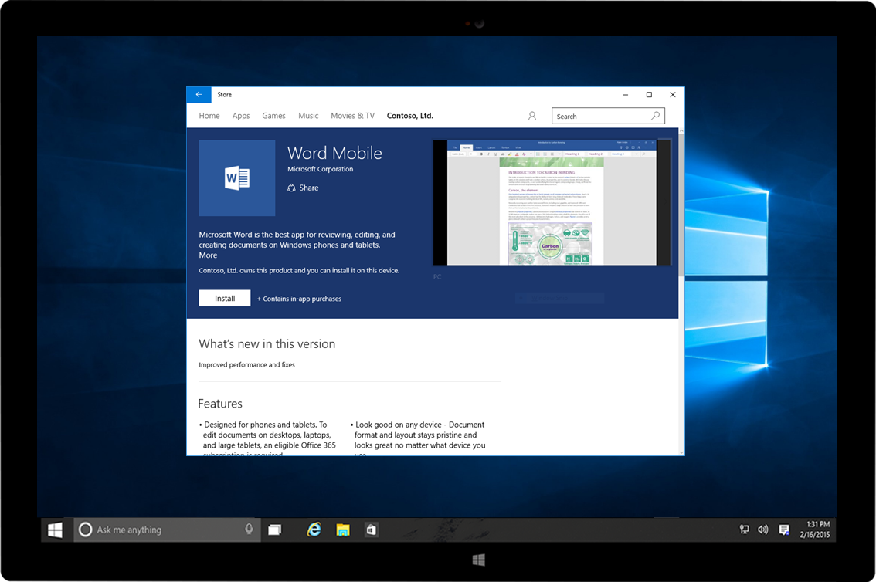

Slide 11
Demo: Windows Store for Business
What does Alice see when she is on the move?
Client for the Phone

Slide 12
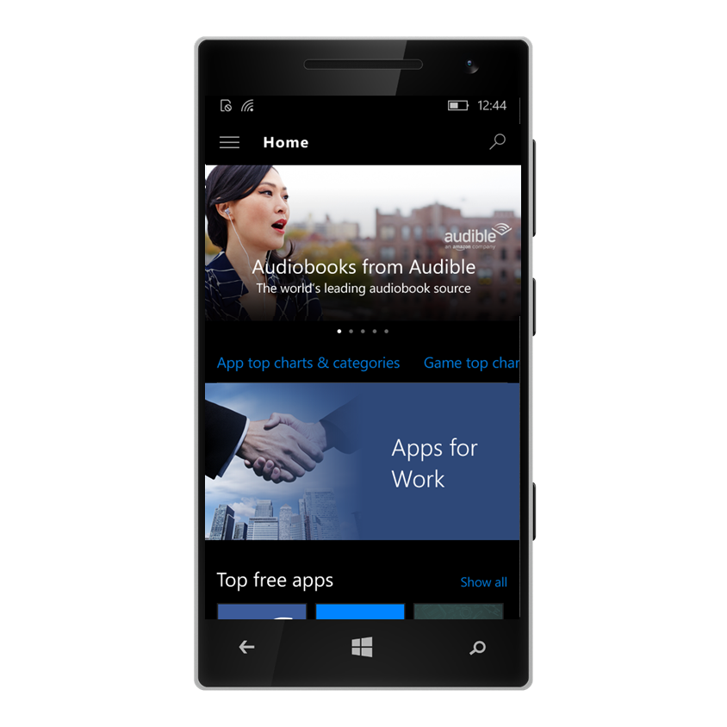

Slide 13
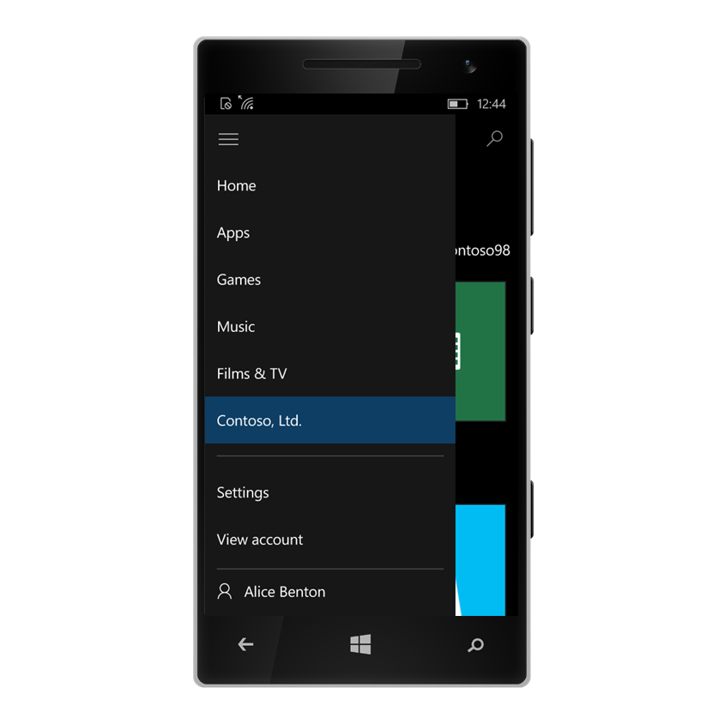

Slide 15
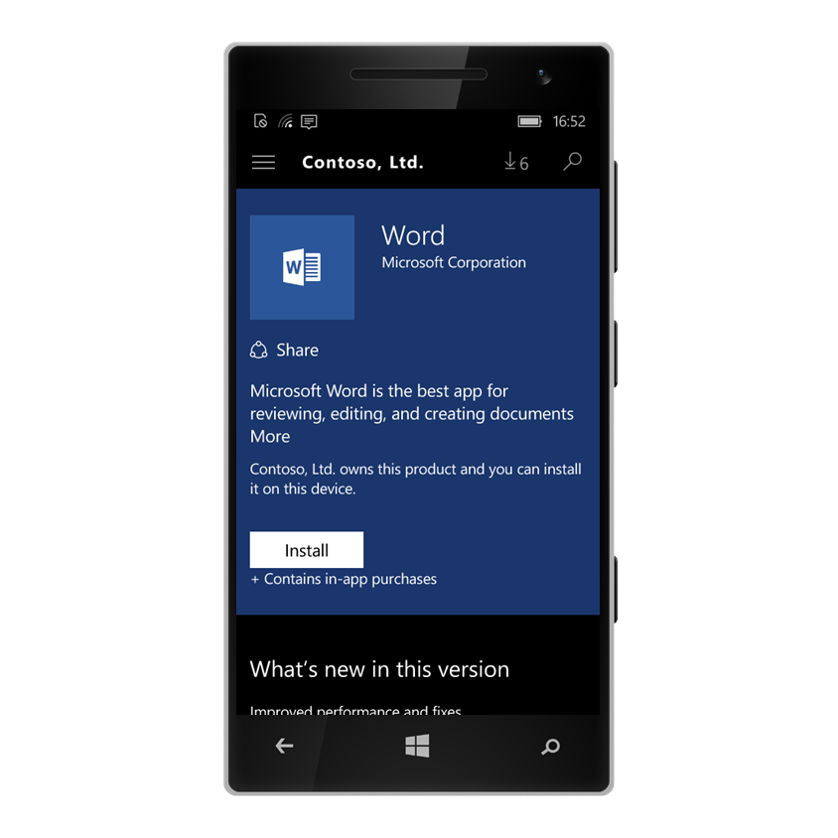

Slide 16
Demo: Windows Store for Business
What does Jerry see?
The IT Professional

Slide 17
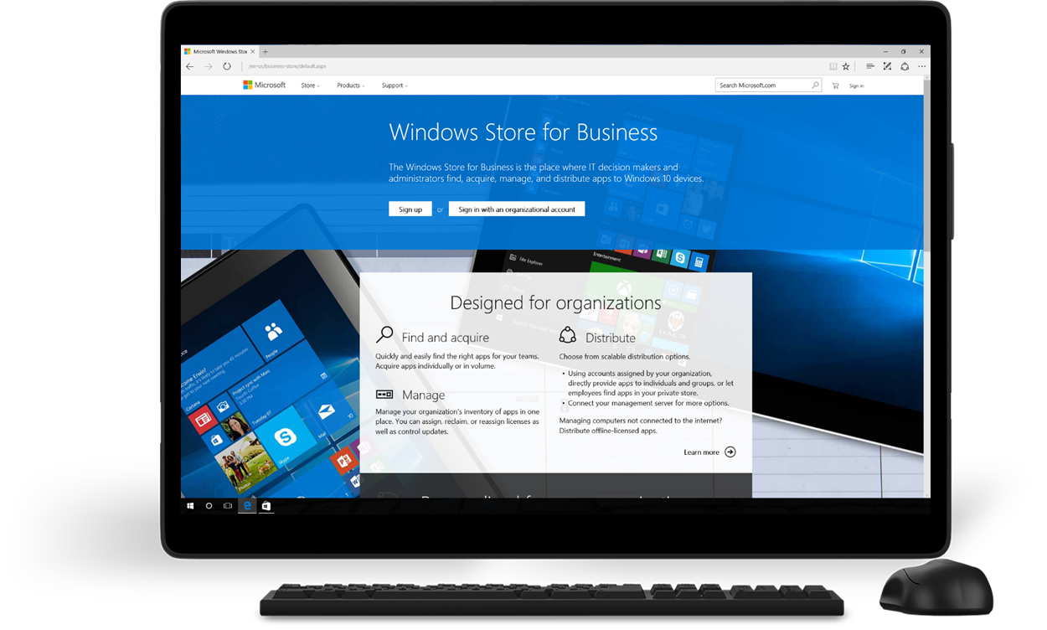
Notes:
Windows Store for Business sign up page http://microsoft.com/business-store provides details about capabilities, content, availability and a brief description of the simple sign up process.

Slide 18
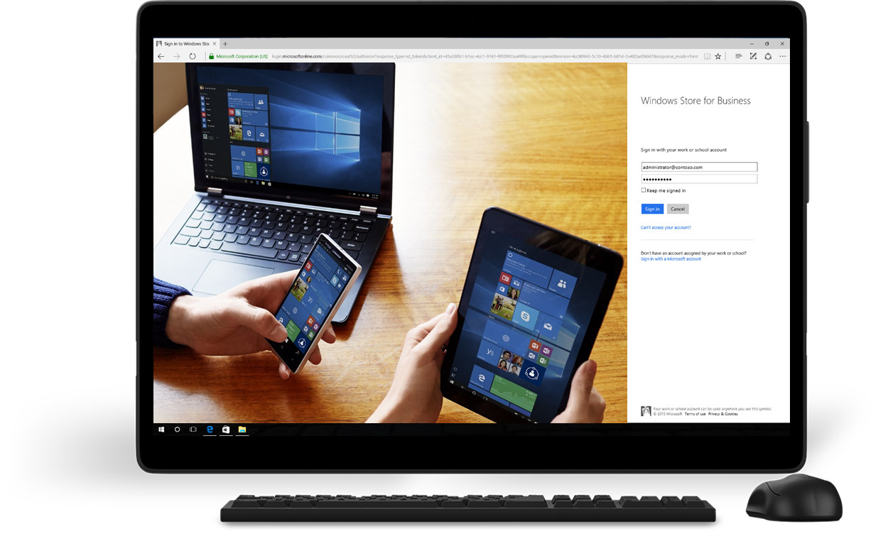

Slide 19


Slide 20
Demo: Windows Store for Business
Shen the independent software vendor
The line-of-business Developer

Slide 21
Flexible licensing app model
Online
Online
Offline
Requires the use of organizational identity based on Microsoft Azure AD for all users
Installation managed and deployed by the Windows Store
Licenses tracked by Windows Store
Updates installed via Windows Update
Default licensing model for all Windows Store for Business apps
No requirement for organizational identity based on Microsoft Azure AD for users (required for IT professionals to acquire apps)
Installation files are downloaded and deployed using org’s infrastructure
No license tracking on Windows Store side
Updates installed via Windows Update
Developer needs to opt-in for offline licensing for the app to be available for offline licensing
Private store
Direct Assignment
MDM/EMM Solutions
Computer imaging
Manual deployment
MDM/EMM Solutions

Slide 22
Demo: Side loading

Slide 23
Sign up today microsoft.com/business-store

